Slide 1
Computer Networks
Network layer
Network layer -- May 2004
Notes:
4. Network Layer - congestion
February 2006
Computer Networks

Slide 2
Network Layer
Design issues
Routing
Congestion
Internetworking
Internet Protocols
Multimedia or QoS
General principles
Prevention policies
Handling virtual circuit subnets
General techniques
Jitter control
Network layer -- May 2004

Slide 3
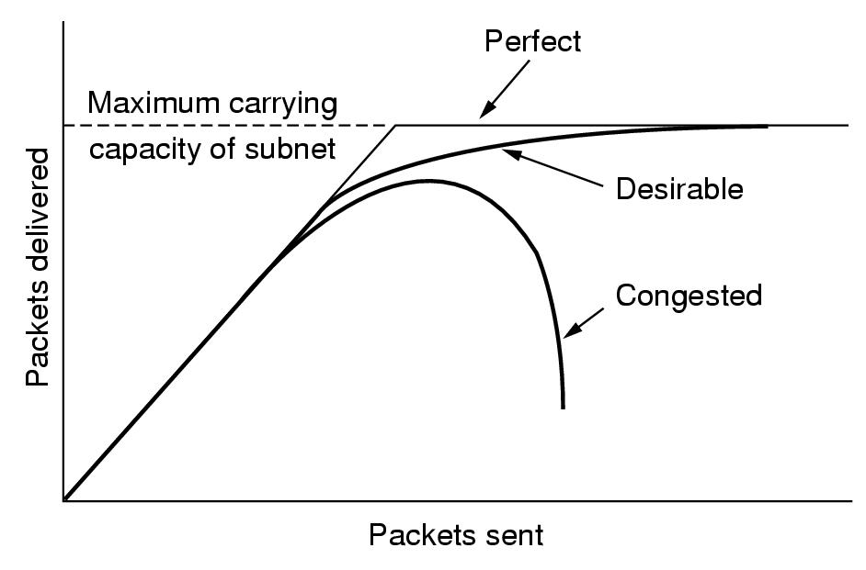
Congestion?
Too many packets in (a part of) the subnet!
Network layer -- May 2004
Notes:
4. Network Layer - congestion
February 2006
Computer Networks

Slide 4
Congestion?
Too many packets in (a part of) the subnet!
caused by
  the same output line is used by many input lines
  mismatch between system parts
    slow processor
    low bandwidth lines
tends to feed upon itself
Congestion control <> flow control
  Congestion: global issue
  Flow control: point-to-point
Network layer -- May 2004
Notes:
4. Network Layer - congestion
February 2006
Computer Networks

Slide 5
Congestion: principles
Control theory viewpoint
open loop closed loop
How? Good design
  Make sure the problem does not occur
Tools
  Decide when to accept traffic
  Decide when to discard packets and which ones
  Make scheduling decisions in the subnet
Monitor: where and when congestion?
  % packets discarded
  average queue length
  number of packets that time out
  average packet delay
Pass collected info to places where actions can be taken = source of traffic
  explicit <> implicit feedback
  explicit: (extra) packet, flags (in other packets), probe packets
Adjust system operation
  Increase resources: bandwidth
  Decrease load: deny, degrade service
Network layer -- May 2004

Slide 6
Network Layer
Design issues
Routing
Congestion
Internetworking
Internet Protocols
Multimedia or QoS
General principles
Prevention policies
Handling virtual circuit subnets
General techniques
Jitter control
Network layer -- May 2004

Slide 7
Congestion: prevention
Minimize congestion
Layer | Policies
Transport | Retransmission policy Out-of-order caching policy Acknowledgement policy Flow control policy Timeout determination
Network | Virtual circuits <> datagrams in subnet Packet queueing and service policy Packet discard policy Routing algorithm Packet lifetime management
Data link | See transport layer
Network layer -- May 2004

Slide 8
Network Layer
Design issues
Routing
Congestion
Internetworking
Internet Protocols
Multimedia or QoS
General principles
Prevention policies
Handling virtual circuit subnets
General techniques
Jitter control
Network layer -- May 2004

Slide 9
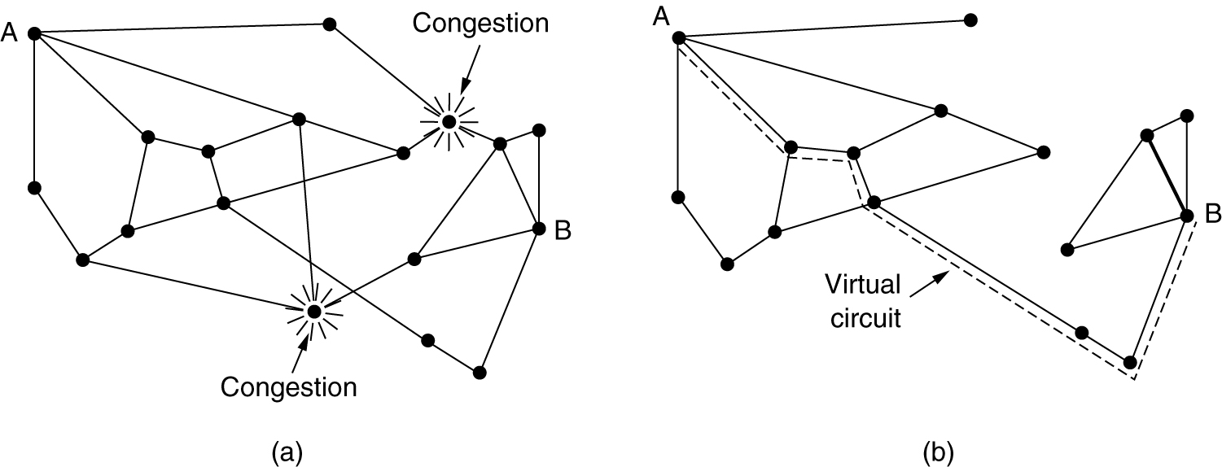
Virtual circuit subnets
Dynamic approach: act when needed
Admission control
  No new virtual circuits when congestion is signalled
  e.g. telephone network
Route new virtual circuits around problem areas
Network layer -- May 2004

Slide 10
Virtual circuit subnets
Dynamic approach
Admission control
Route new virtual circuits around problem areas
Negotiation when virtual circuit is set up
  About kind of traffic + service desired
  Resource reservation in subnet
    Line capacity
    Buffers in routers
  No congestion
  Unused resources
Network layer -- May 2004

Slide 11
Network Layer
Design issues
Routing
Congestion
Internetworking
Internet Protocols
Multimedia or QoS
General principles
Prevention policies
Handling virtual circuit subnets
General techniques
Jitter control
Network layer -- May 2004

Slide 12
General techniques
Approaches: reduce traffic by
  Requesting senders
  local measurements + info packets to senders
  + hope for ….
  Throwing away packets
  local measurements + local actions to reduce load
Network layer -- May 2004

Slide 13
Source based approach
Basic algorithm
  Router monitors utilisation of output lines
    u recent utilisation: 0 ≤ u ≤ 1
    good estimate of u
    u_{new} = a × u_{old} + (1 – a ) × f
  In case of overload: u_{new} > threshold
    Output line enters warning state
    Some action is taken:
      Warning bit
      Choke packets
      Hop-by-hop choke packets
f | Instantaneous line utilisation
a | constant
Network layer -- May 2004

Slide 14
Source based approach
Warning bit
  Output line in warning state
    Warning bit set in header
    Destination copies bit into next ack
    Source cuts back traffic
  Algorithm at source
    As long as warning bits arrive: reduce traffic
    Less warning bits: increase traffic
  Problems
    voluntary action of host!
    correct source selected?
  Used in
    DecNet
    Frame relay
Network layer -- May 2004

Slide 15
Source based approach
Choke packet
  In case of overload: router sends choke packet to host causing the overload
  Host receiving choke packet
    reduces traffic to the specified destination
    ignores choke packets for a fixed interval
    new choke packets during next listening interval?
      Yes: reduce traffic
      No: increase traffic
  Problems:
    voluntary action of host!
    correct host selected?
Network layer -- May 2004

Slide 16
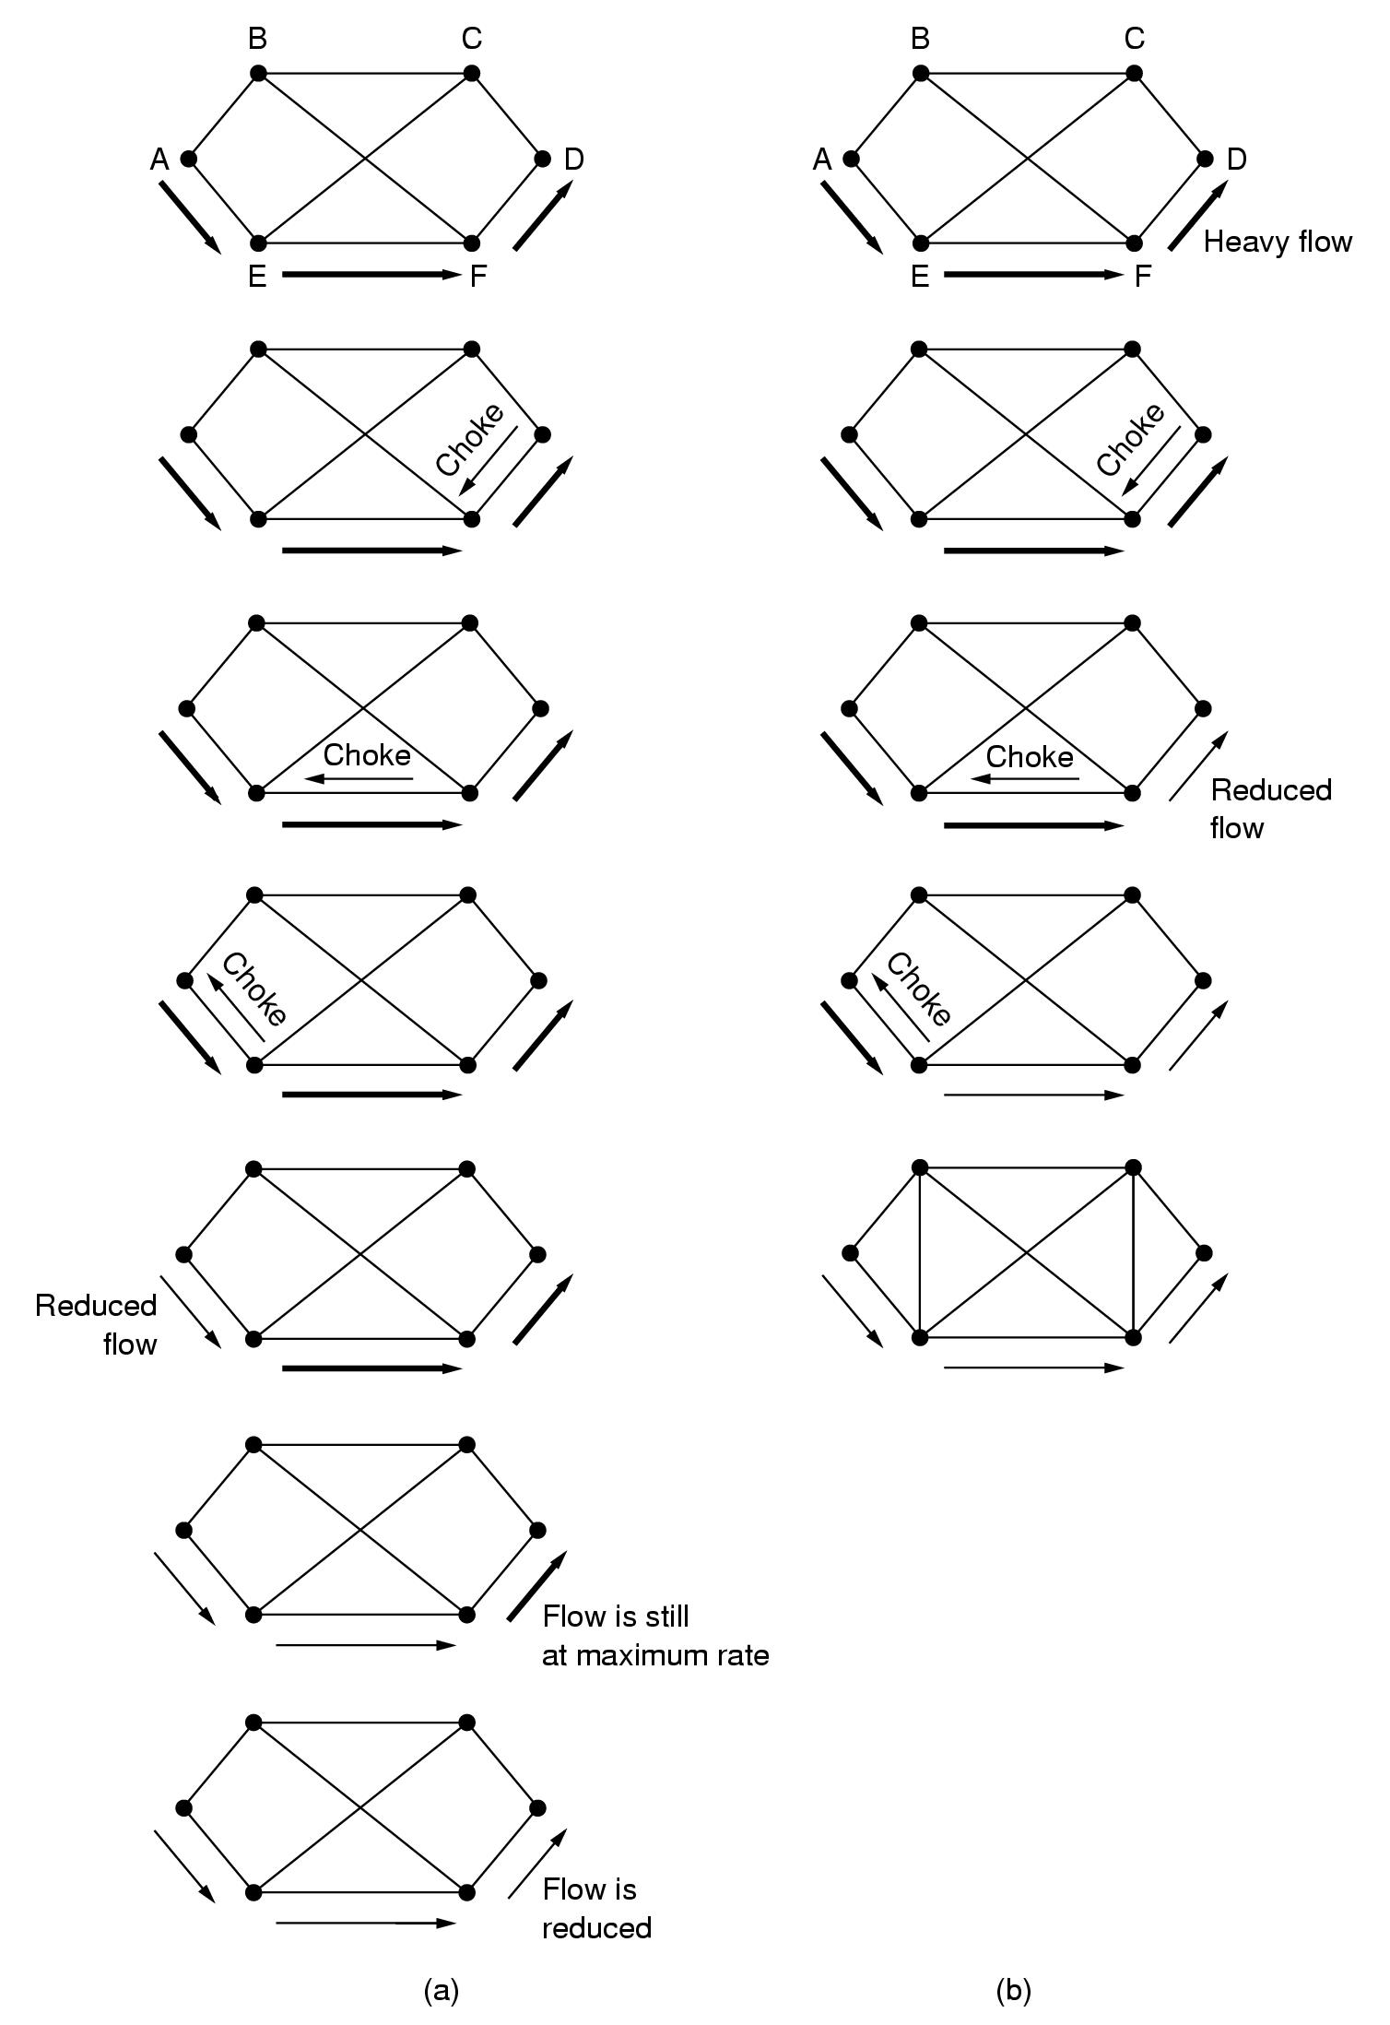
Source based approach
Choke packets:
  Example showing slow reaction
  Solution: Hop-by-Hop choke packets
Network layer -- May 2004

Slide 17
Source based approach
Hop-by-Hop choke packets
  Have choke packet take effect at every hop
  Problem: more buffers needed in routers
Network layer -- May 2004

Slide 18
Load shedding
Throw away packets that cannot be handled!!
Packet selection?
  Random
  Based on application
    File transfer: discard new packet
    Multimedia: discard old packet
  Let sender indicate importance of packets
    Low, high priority
    Incentive to mark a packet with low priority
      Price
      Allow hosts to exceed agreed upon limits
Random early detection …
Network layer -- May 2004

Slide 19
Load shedding
Throw away packets that cannot be handled!!
Packet selection?
Random early detection
  Discard packets before all buffer space is exhausted
  Routers maintain running average of queue lengths
  Select at random a packet
  Inform source?
    Send choke packet? ➔ more load!!
    No reporting
  When does it work?
    Source slows down when packets are lost
Network layer -- May 2004

Slide 20
Network Layer
Design issues
Routing
Congestion
Internetworking
Internet Protocols
Multimedia or QoS
General principles
Prevention policies
Handling virtual circuit subnets
General techniques
Jitter control
Network layer -- May 2004

Slide 21
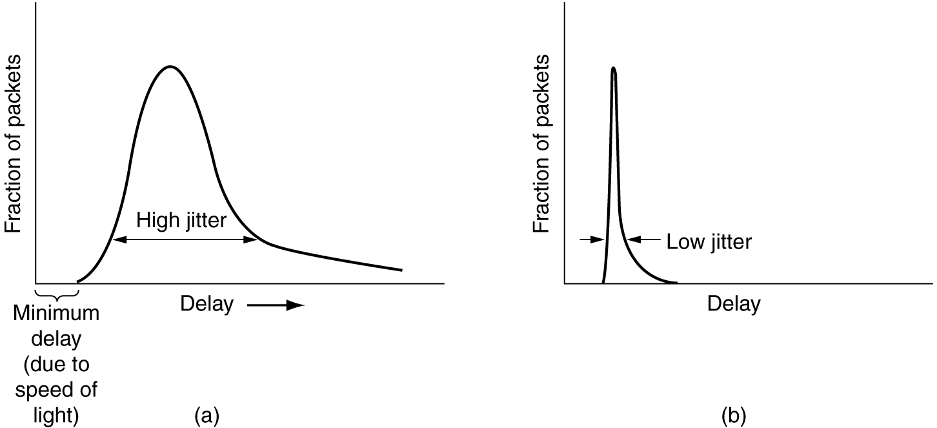
Congestion: jitter control
Important for audio and video applications?
  not delay
  variance of delay
Network layer -- May 2004

Slide 22
Congestion: jitter control
Jitter = variation in packet delay
Compute feasible mean value for delay
  compute expected transit time for each hop
  router checks to see if packet is
    behind
    ahead schedule
  behind: forward packet asap
  ahead: hold back packet to get it on schedule again
Buffering? Depends on characteristics:
  Video on demand: ok
  Videoconferencing: nok
Network layer -- May 2004

Slide 23
Network Layer
Design issues
Routing
Congestion
Internetworking
Internet Protocols
Multimedia or QoS
Network layer -- May 2004
Notes:
4. Network Layer - congestion
February 2006
Computer Networks

Slide 24
Computer Networks
Network layer
Network layer -- May 2004
Notes:
4. Network Layer - congestion
February 2006
Computer Networks

